Slide 1

Hand-Detection for Sign Language Aid on Android-Based Smart Glasses
Center for Project-Based Learning
Luca Specht
Prof. Dr. Luca Benini
Semester Thesis Final Presentation
11. July 2023, ETH Zürich

Slide 2
Contents
Introduction
Background
Implementation
Results
Conclusion

Slide 3
Introduction
Hand Detection
Wearables
YOLO

Slide 4

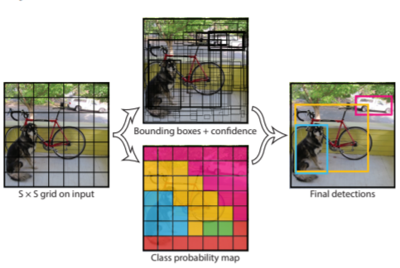
Background – YOLO
asdf

Slide 5
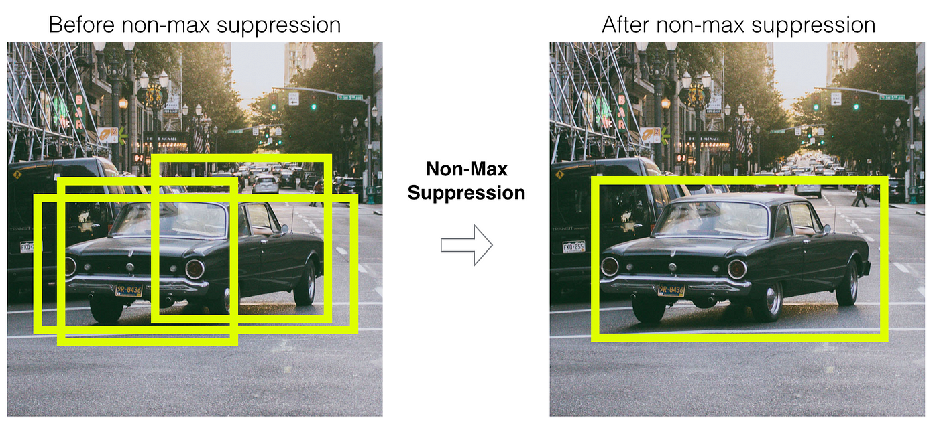
Background – YOLO
adf

Slide 6
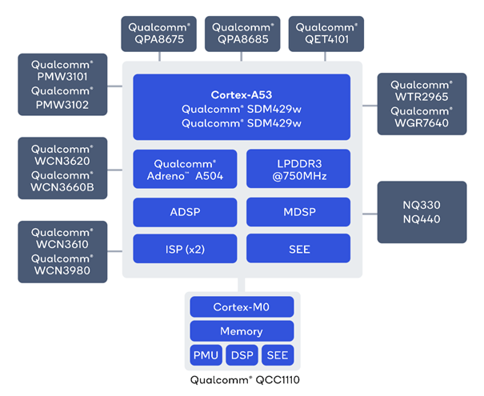
Background – SDW4100
adf

Slide 7
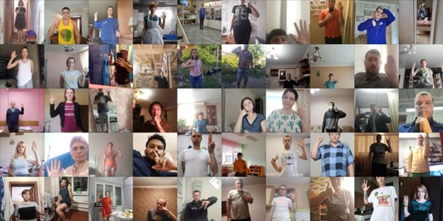
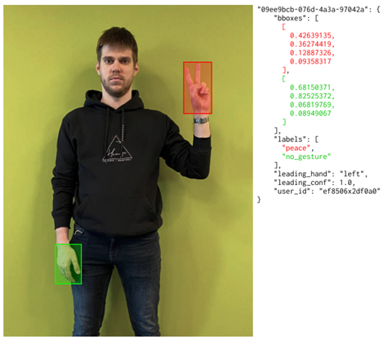
Implementation – Dataset
asdf

Slide 8
Implementation – Training
adsf

Slide 9
Implementation – Optimizations
asdf

Slide 10
Implementation – Export
asdf

Slide 11
Implementation – Android App

Slide 12
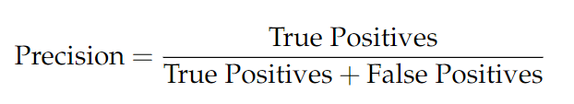
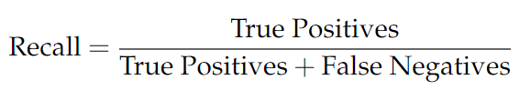
Results – Metrics
Precision
Recall
PR Curve
AP and mAP

Slide 13
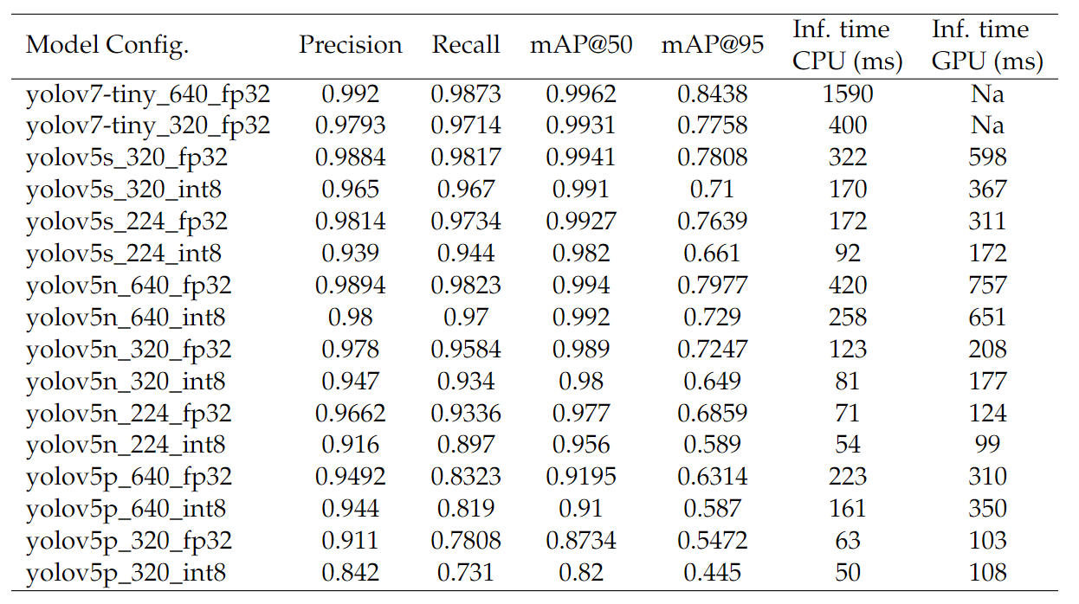
Results – Overview

Slide 14
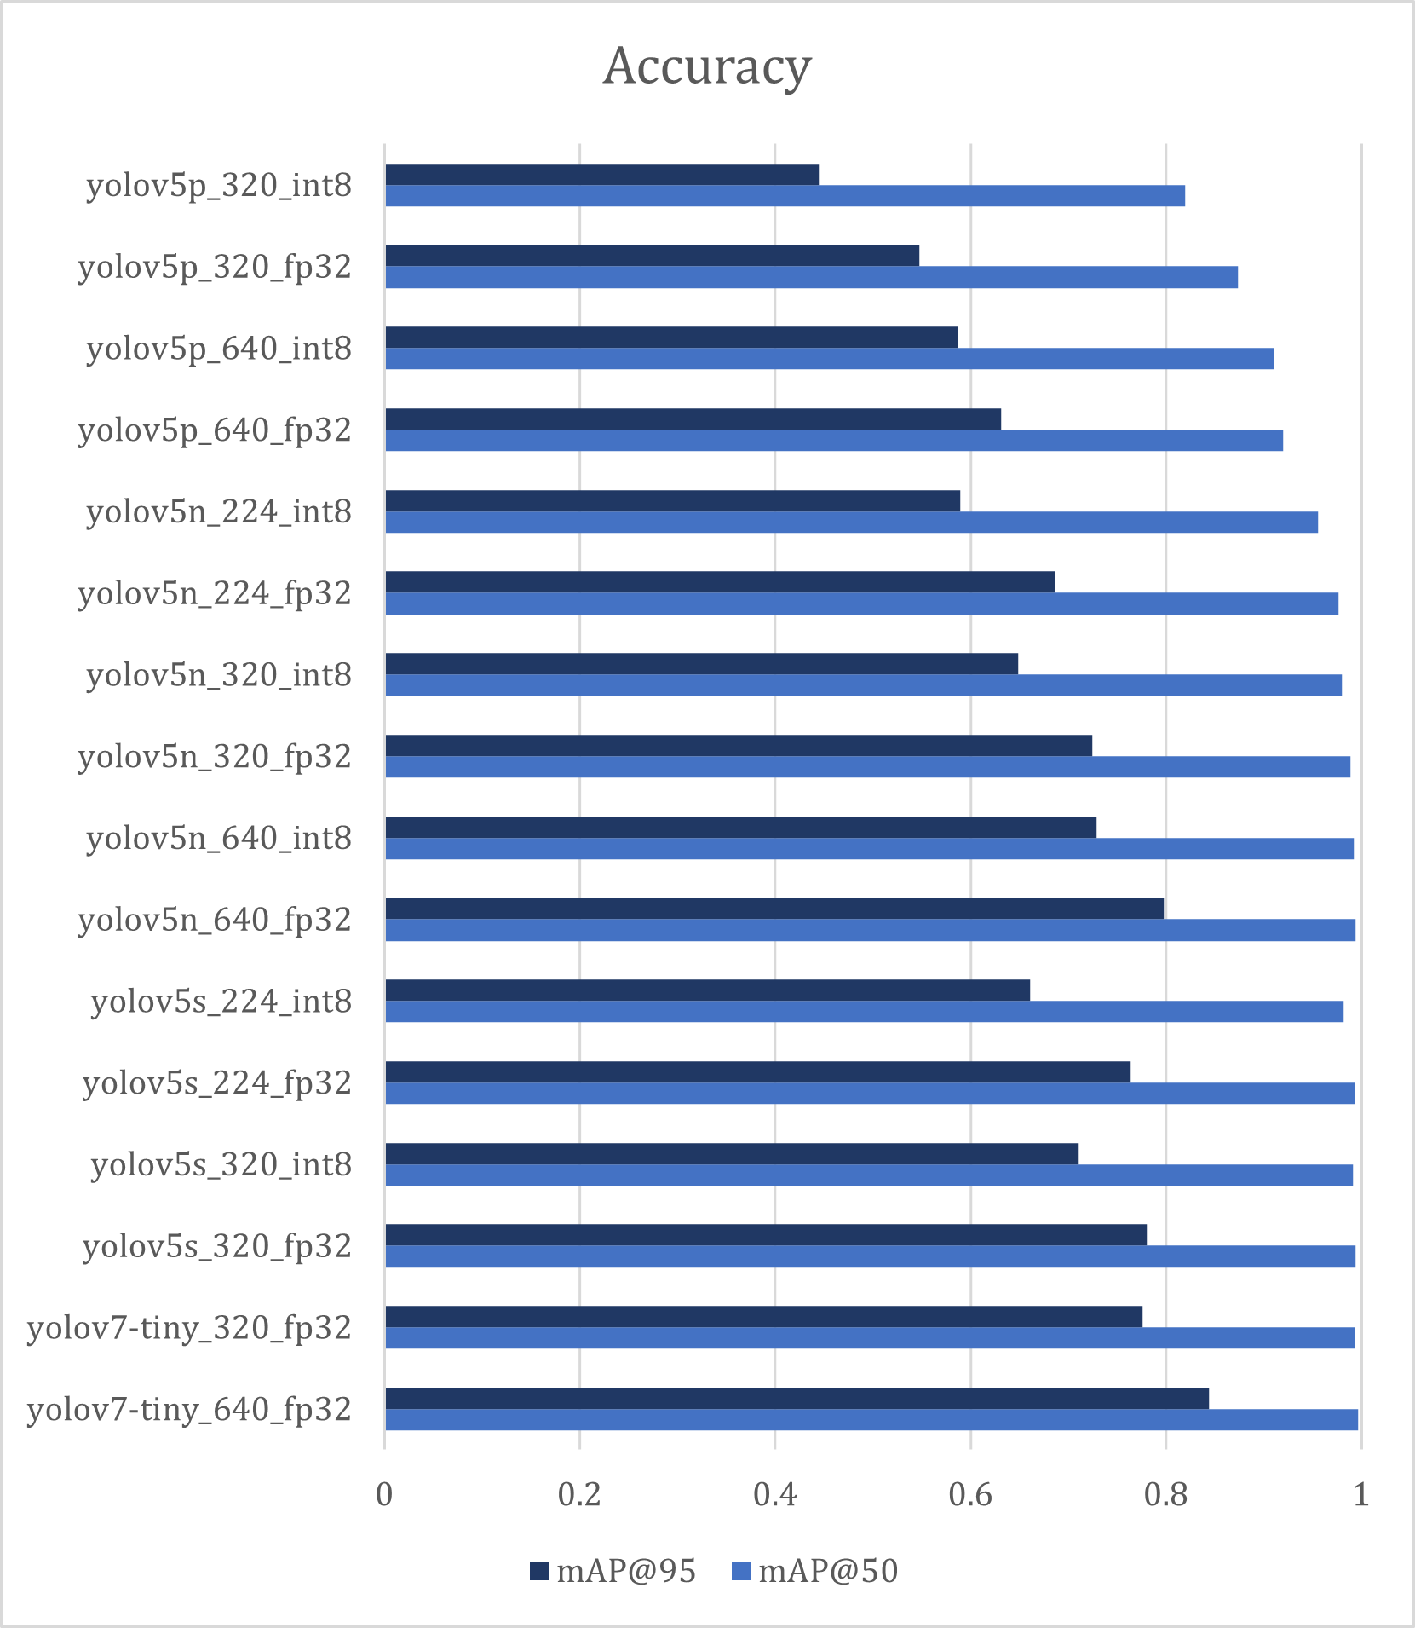
Results – Accuracy
adf

Slide 15
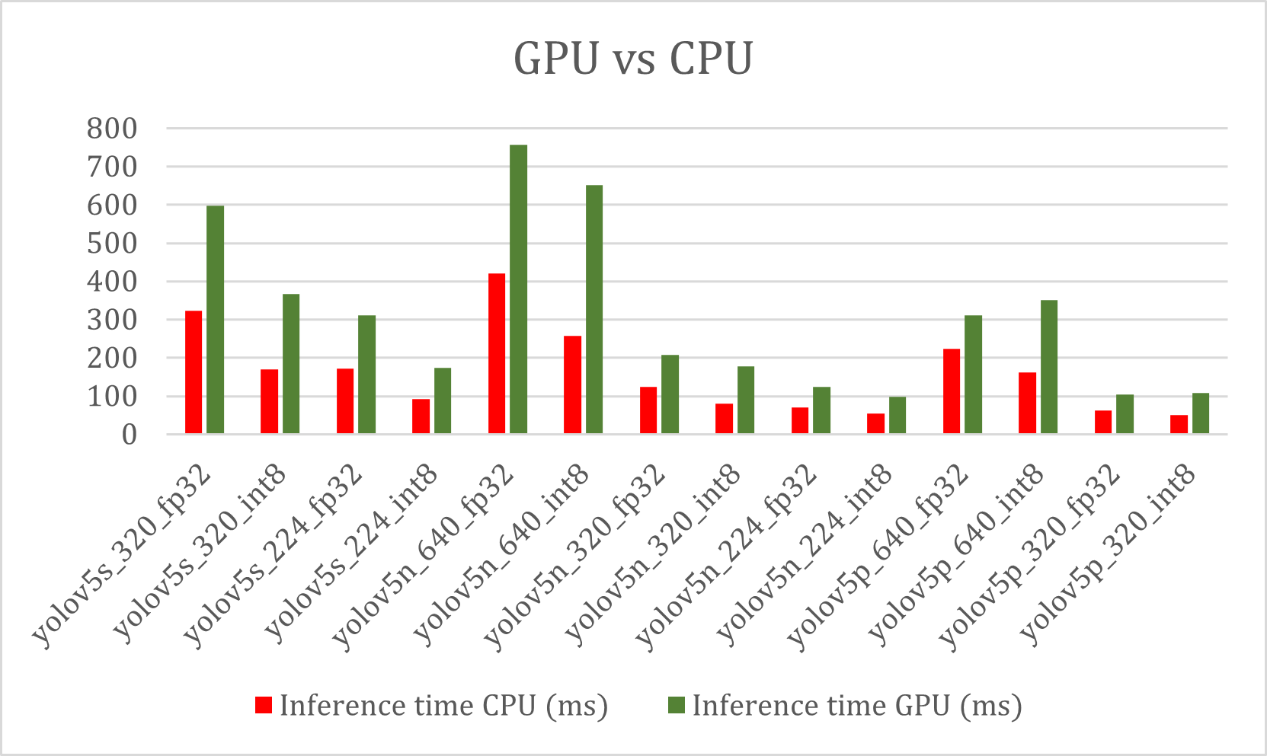
Results – GPU vs. CPU
asdf

Slide 16
Results – Input Size
adf

Slide 17
Results – Quantization
asdf

Slide 18
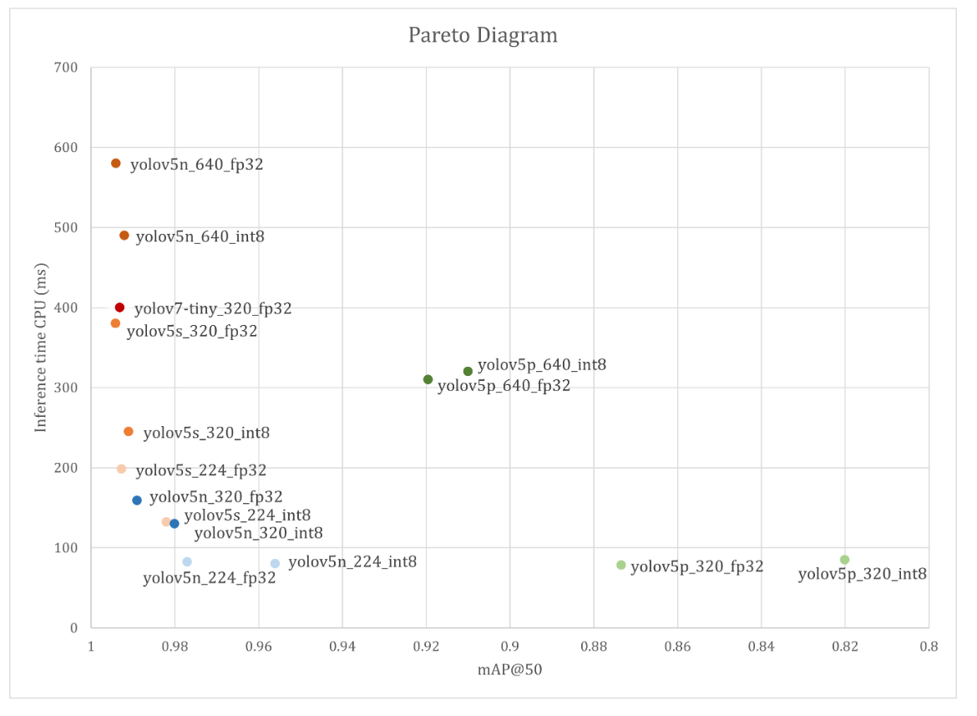
Results – Pareto Diagram

